Slide 1
Cloud Computing
By Vishal Pimple

Slide 2
What is cloud computing?
Cloud computing is the on-demand delivery of IT resources over the Internet with pay-as-you-go pricing. Instead of buying, owning, and maintaining physical data centers and servers, you can access technology services, such as computing power, storage, and databases, on an as-needed basis from a cloud provider like Amazon Web Services (AWS).

Slide 3
Why Cloud Computing?
Cloud is incredibly important for businesses because it provides
flexibility, data recovery, virtually no maintenance, and easy
access to its users.
Furthermore, its high level of security provides ease of mind as
you can rest assured knowing your data is right where it needs to
be and only accessible by authorized individuals.

Slide 4
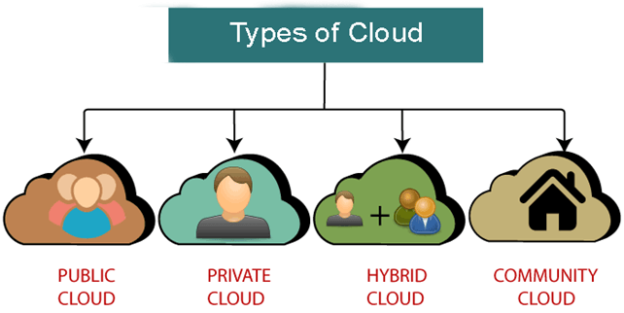
Types of Cloud

Slide 5
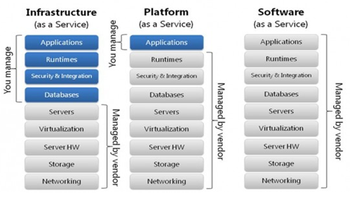
Cloud Service Models

Slide 6
advantages
On demand service
Broad network access
Resource polling
Rapid Elasticity
Low Cost
Reliable & secure

Slide 7
Cloud Service Provider Companies
Cloud Service providers (CSP) offers various services such as Software as a Service, Platform as a service, Infrastructure as a service, network services, business applications, mobile applications, and infrastructure in the cloud. The cloud service providers host these services in a data center, and users can access these services through cloud provider companies using an Internet connection
Ex.
Amazon Web Services (AWS)
Microsoft Azure
Google Cloud Platform

Slide 8
AWS Simple Storage Service (S3):
From the aforementioned list, S3, is the object storage service provided by AWS. It is probably the most commonly used, go-to storage service for AWS users given the features like extremely high availability, security, and simple connection to other AWS Services. AWS S3 can be used by people with all kinds of use cases like mobile/web applications, big data, machine learning and many more.

Slide 9
Amazon Relational Database Service(Amazon RDS)
Amazon Relational Database Service (RDS) is a managed SQL database service provided by Amazon Web Services (AWS). Amazon RDS supports an array of database engines to store and organize data. It also helps in relational database management tasks like data migration, backup, recovery and patching.

Slide 10


